Slide 1
4th Street and O’Brien Street
Intersection Improvements
DES. 1703015
Seymour, Jackson County
Indiana Department of Transportation
Wednesday, September 1
6:00 pm
City of Seymour Police Station
Welcome to the Public Hearing

Slide 2
Project Team
Indiana Department of Transportation (INDOT)
  Chase Schneider, Project Manager
  Annie Walker, Communications Director
City of Seymour
  Bernie Hauersperger, City Engineer
Short Elliott Hendrickson (SEH)
  Glenn Peterson, Project Manager
  Tom Cicero, Client Service Manager
  Scott Hochkin, Design Engineer
  Nate Day, Environmental Planner

Slide 3
Submit Public Comments
In-Person Public Hearing:
  Verbal comment session after presentation using microphone
  Public Comment Form available in information packet
Via e-mail: gpeterson@sehinc.com
INDOT respectfully requests comments be submitted by September 16, 2021
All comments submitted will become part of the public record, and they will be entered into a transcript, reviewed, evaluated, and given full consideration during the decision-making process.

Slide 4
Agenda
Purpose of public hearing
Project Information
  Location
  Purpose and Need
  Proposed Project Improvements
  Maintenance of Traffic
  Land Acquisition Process
  Right-of-Way Requirements
  Alternatives Considered
  Environmental Process
  Anticipated Schedule and Cost

Slide 5
Public Hearing Purpose
Requirement of the National Environmental Policy Act (NEPA)
Opportunity to engage the public in the decision-making process
Solicit comments on the environmental document and design plans
All comments submitted will become part of the public record, and they will be entered into a transcript, reviewed, evaluated, and given full consideration during the decision-making process

Slide 6
Public Hearing Process
Legal notice advertised in The Republic newspaper on August 18 and 26
Notice was mailed to adjacent residences
Physical copies of the environmental document available at:
  Jackson County Library
  City of Seymour

Slide 7
Project Stakeholders
Indiana Department of Transportation
Indiana Division Federal Highway Administration
Jackson County
City of Seymour
Elected and local officials
Residents
Commuters
Businesses
Emergency services
Schools
Churches
Community organizations

Slide 8
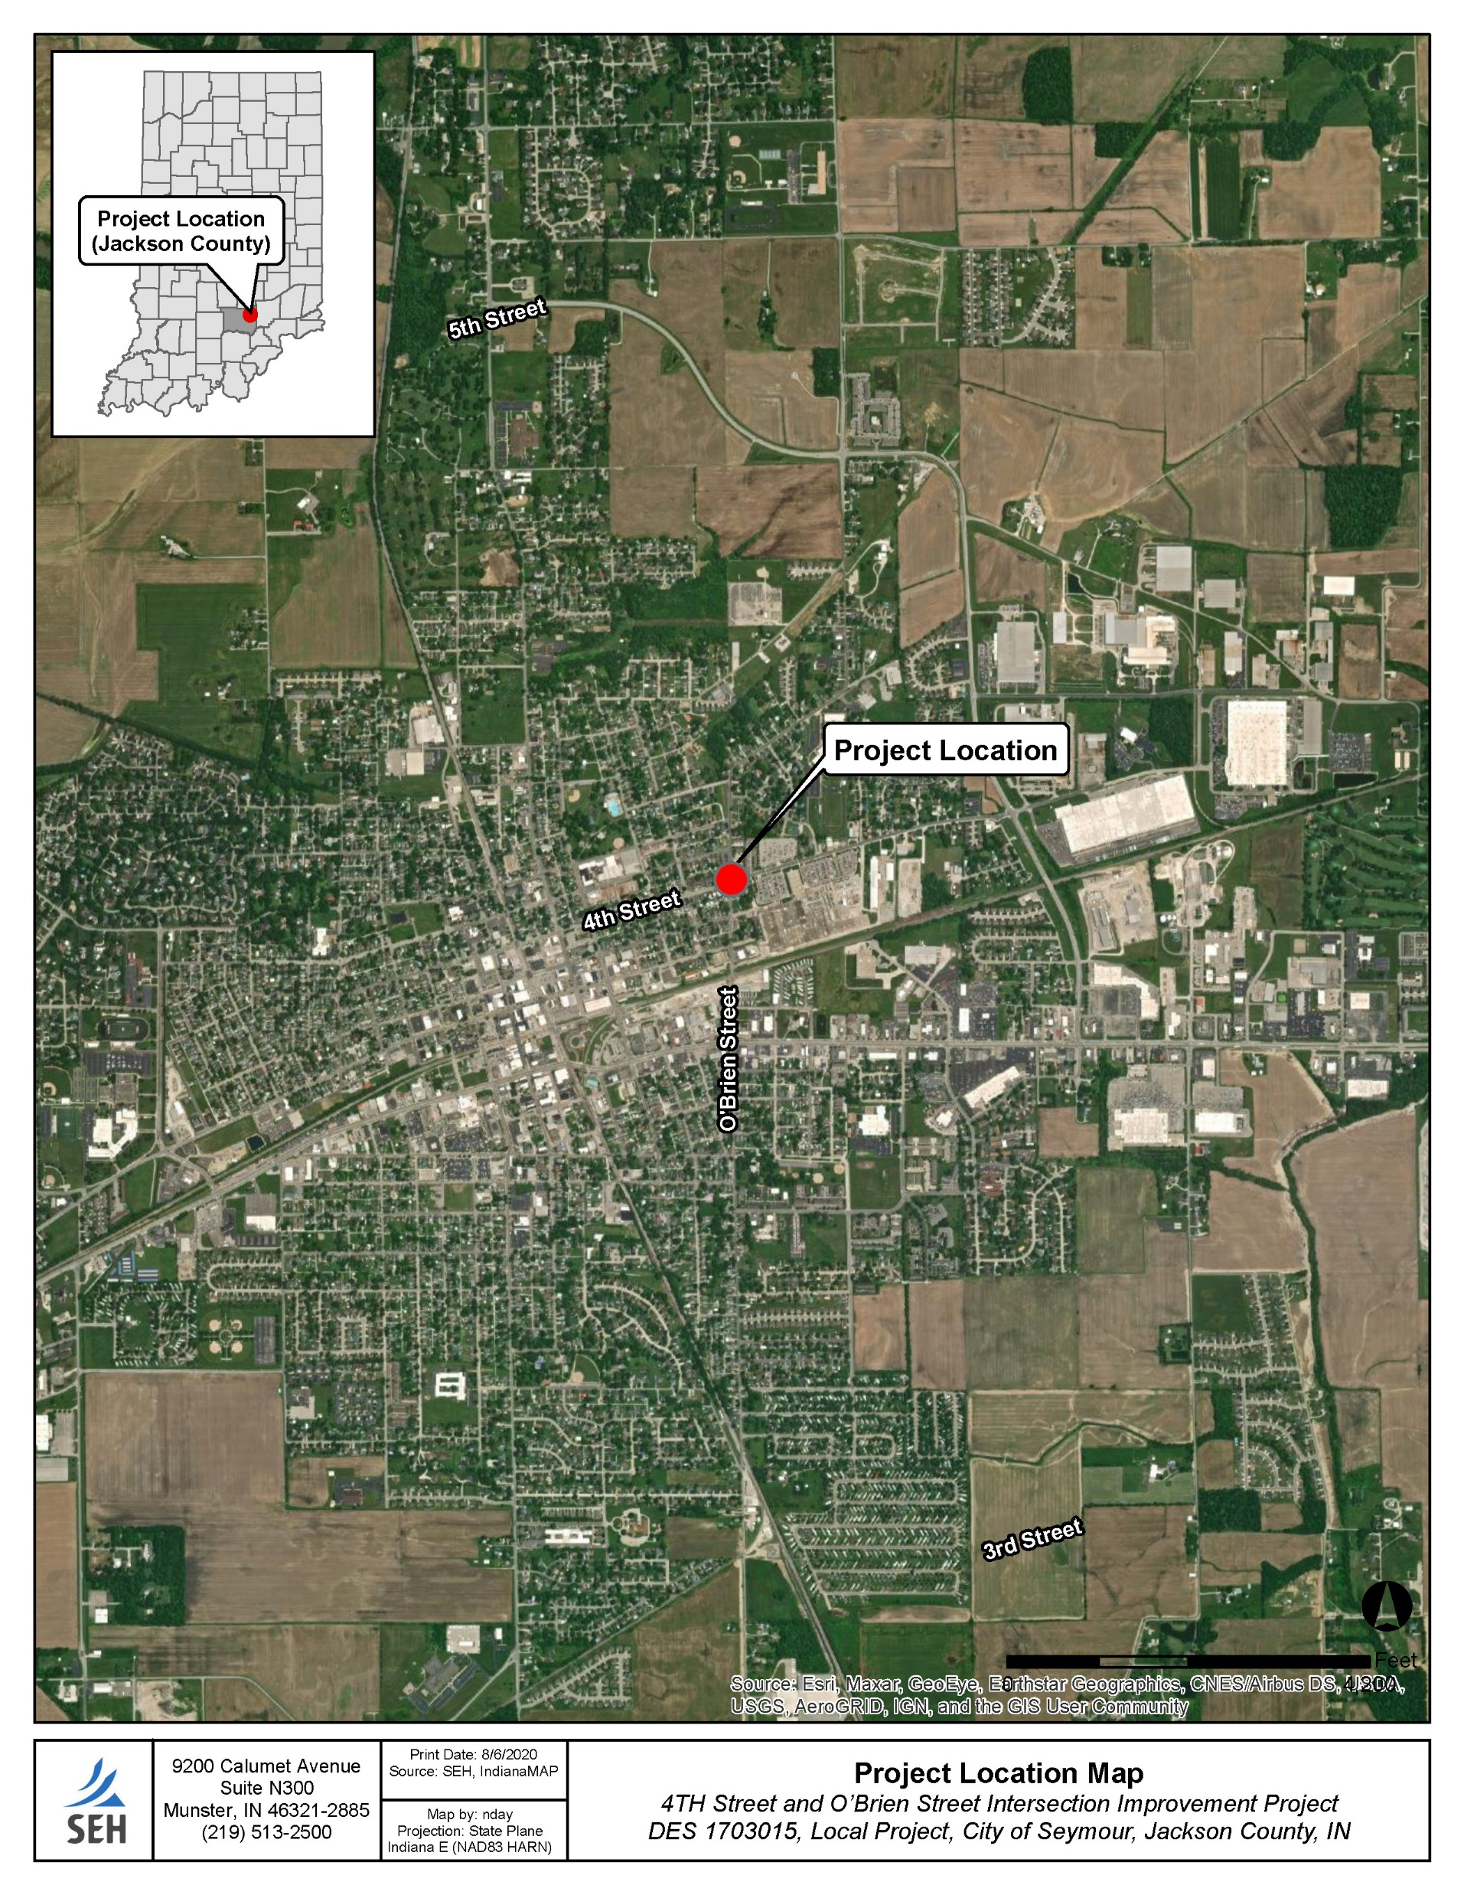
Project Location

Slide 9
Purpose and Need
Three transportation needs have been identified at the O'Brien Street and 4th Street intersection:
Bike accommodations
Pedestrian accommodations
Improved Level of Service (LOS)
PURPOSE
To improve the pedestrian, bike, and motorized vehicle environment at the intersection of O’Brien Street and 4th Street. The project’s target LOS is B.

Slide 10
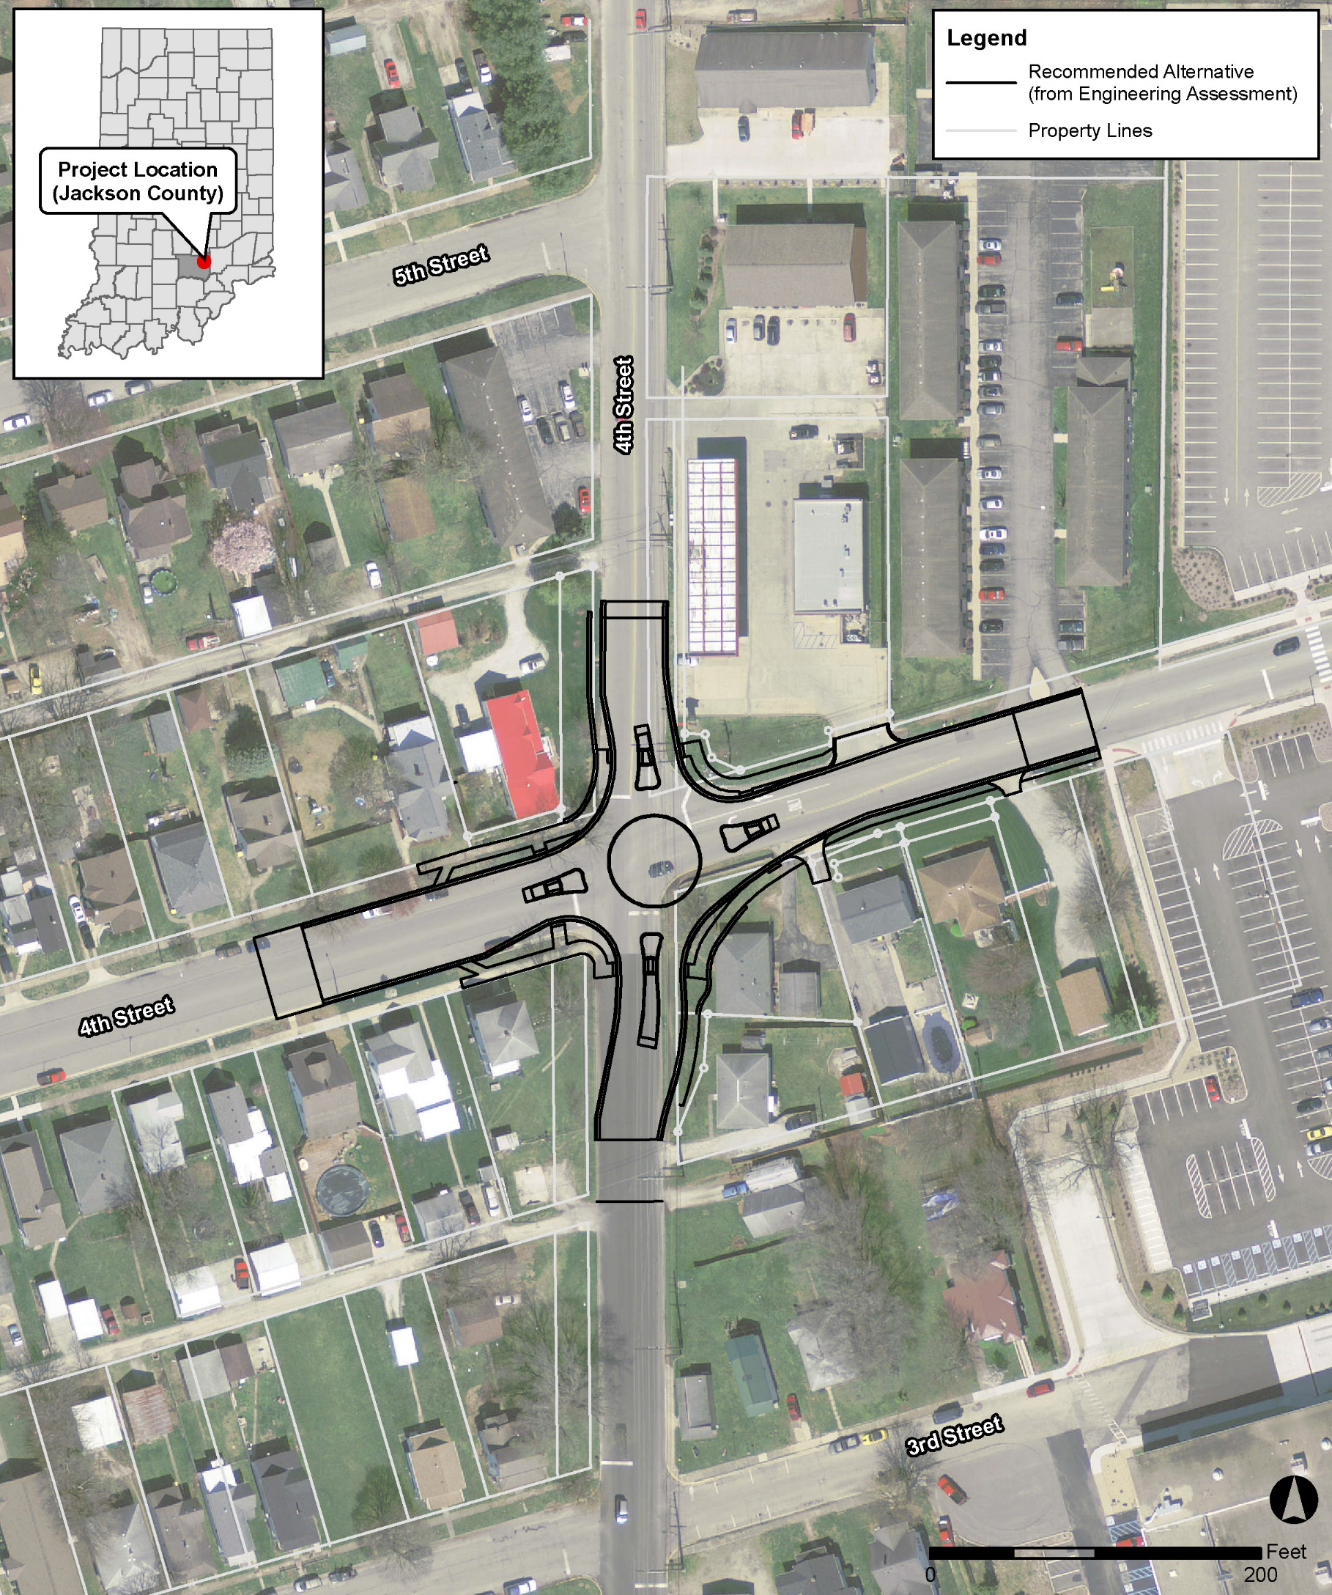
Proposed Improvements
Mini Roundabout
Sidewalks
Bike Lanes

Slide 11
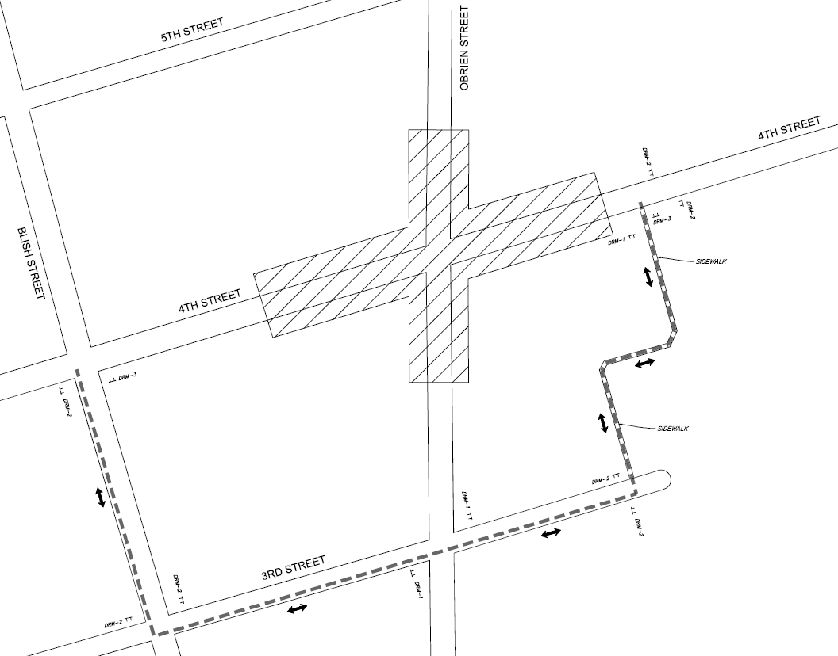
Maintenance of Traffic – Bike and Pedestrian

Slide 12
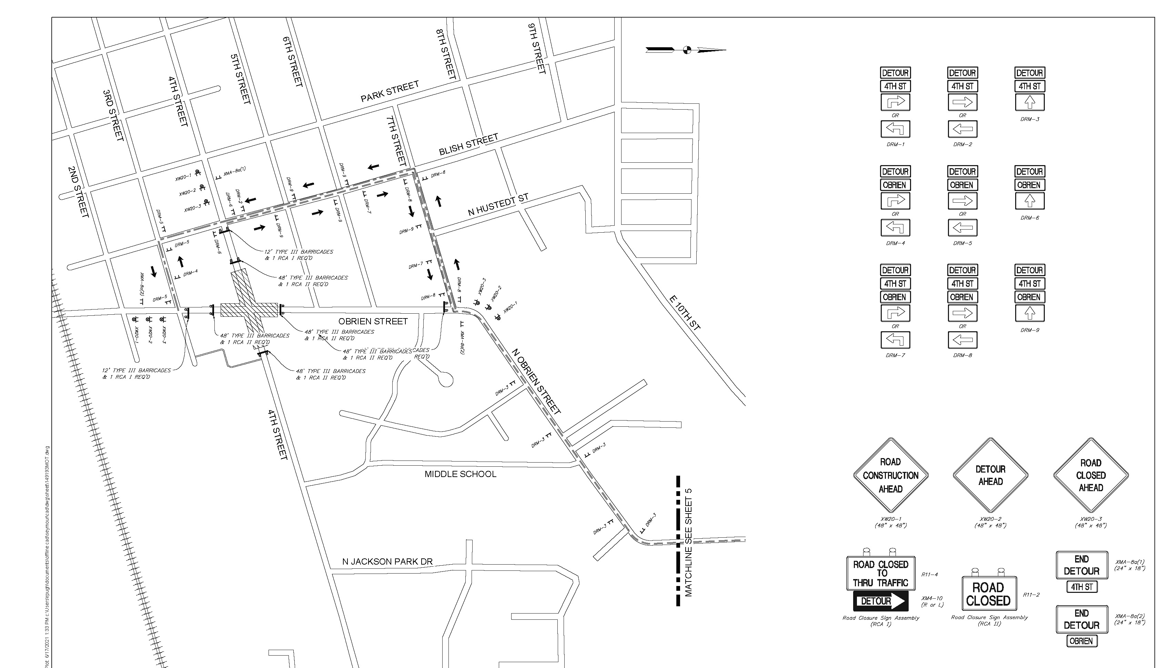
Maintenance of Traffic – Vehicle

Slide 13
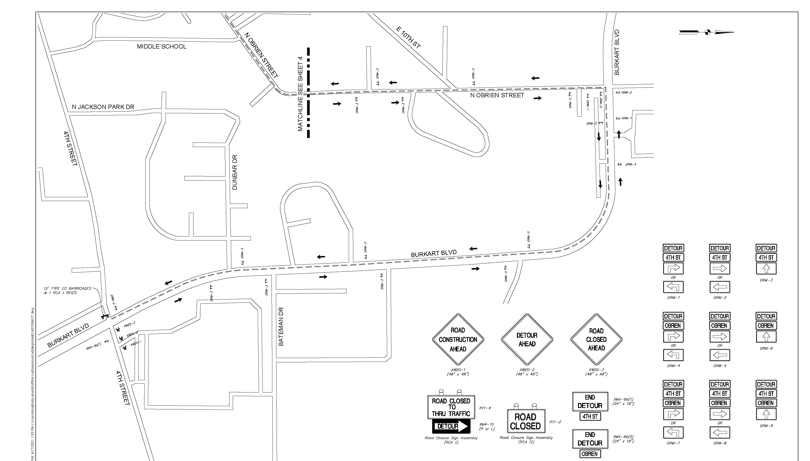
Maintenance of Traffic – Vehicle

Slide 14
Land Acquisition Process
New permanent right-of-way acquisition anticipated
One relocation
Land acquisition process must follow the Uniform Act of 1970 which requires offer for just compensation
The brochure that explains process can be found at https://www.fhwa.dot.gov/real_estate/uniform_act/acquisition/real_property.cfm and at the sign in table at the in-person Public Hearing.

Slide 15
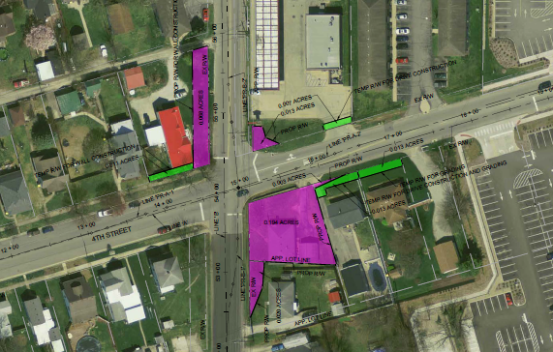
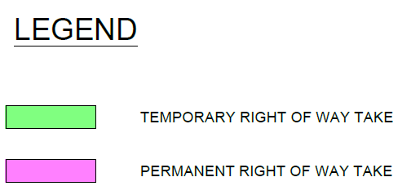
Right-of-Way Requirements
0.298 Acres of Permanent Right-of-Way
0.044 Acres of Temporary Right-of-Way

Slide 16
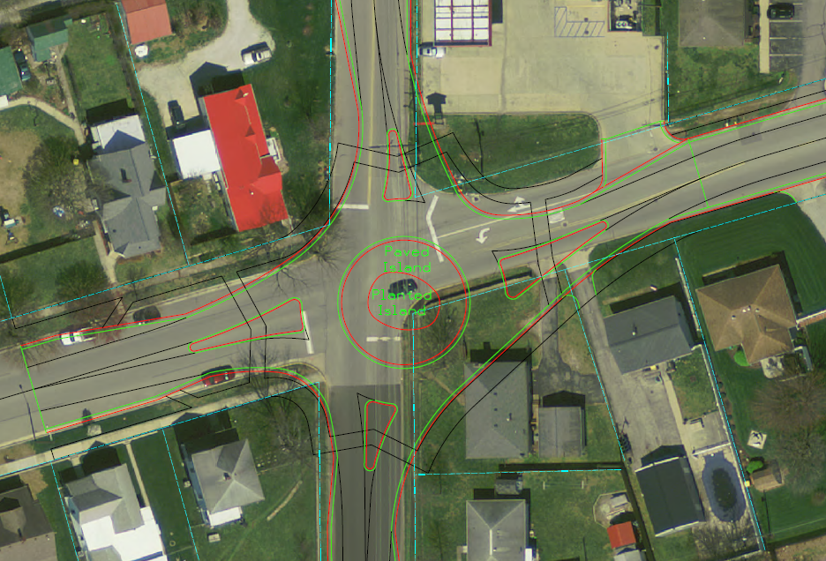

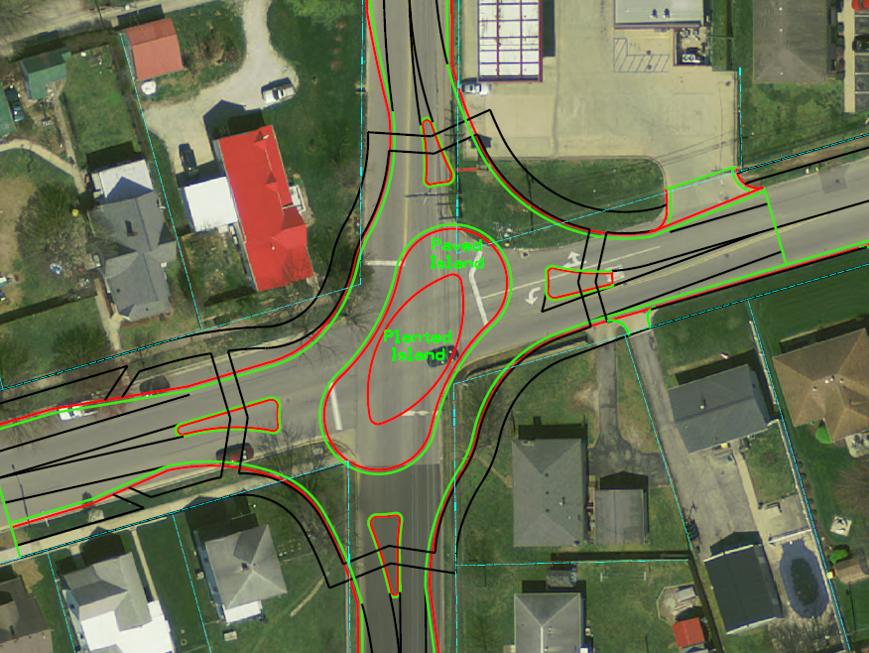
Alternatives Considered
No Build
Traditional Circular Roundabout
Peanut Roundabout
Signalized Intersection

Slide 17
NEPA Environmental Process
  National Environmental Policy Act (NEPA)
  Requires INDOT to analyze and evaluate the impacts of a proposed project to the natural and socio-economic environments
  Impacts are analyzed, evaluated, and described in an environmental document
    What are the impacts this project might have on the community?
    How can impacts be avoided?
    Can impacts be minimized?
    Mitigation for impacts?
  Environmental document released for public involvement
    August 1, 2021
    Available for review at the library and the City of Seymour

Slide 18
Environmental Document
Environmental Process
  Establish purpose and need
  Develop possible alternatives
    The “Do Nothing” alternative is a baseline for comparison
  Evaluate and screen alternatives
  Identify a preferred alternative
  Solicit public comment on environmental document and preliminary design plan
  Address and consider public comment as part of decision-making process
  Finalize and approve environmental document

Slide 19
Examples of Items Evaluated
  Right-of-way
  Streams, wetlands, and other waters
  Floodplains
  Endangered species
  Farmland
  Cultural resources (historic/archaeological)
  Parks and recreational lands (trails)
  Air quality
  Noise
  Community impacts
  Environmental justice
  Hazardous materials
  Permits
  Mitigation
  Public involvement
  Commercial development

Slide 20
Project Development
Project selection
Early coordination
Environmental phase begins
Purpose & Need
Develop alternatives
Preliminary design phase
Release environmental document for public review and comment
Additional work to finalize environmental document and project design
Real estate acquisition
Construction
Public Hearing
Public Involvement – Communicate Project Decision

Slide 21
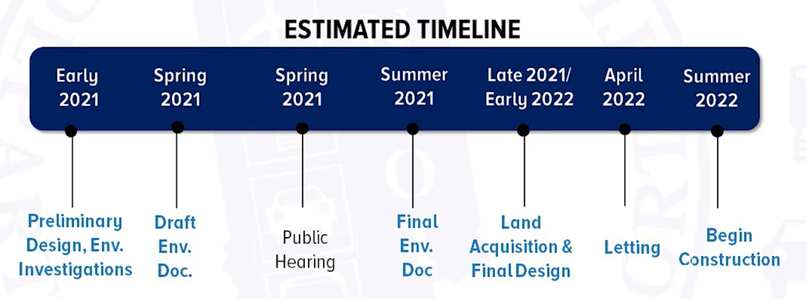
Anticipated Schedule and Cost
The estimated cost for this project is $1,578,000 which includes design, land acquisition and construction.
The project includes Federal funding.

Slide 22
Next Steps
Public and project stakeholder input
  Submit comments by September 16, 2021 via email or in-person at the hearing.
INDOT review and evaluation
  All comments are given full consideration during the decision-making process.
  Address comments, finalize and approve the environmental document, and complete the project design.
Communicate a decision
  INDOT will notify project stakeholders of the decision.
  Work through local media, social media outlets; paid legal notice.
  Make project documents accessible via repositories.

Slide 23
Thank you!

